Slide 1
SDLC and Models

Slide 2
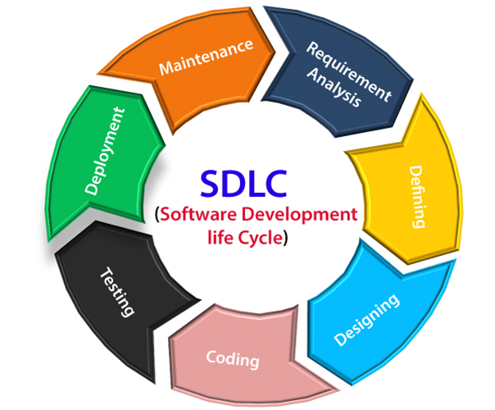
SDLC- Software Development Life Cycle

Slide 3
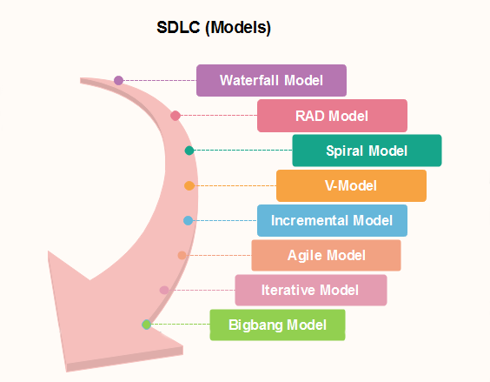
SDLC Models

Slide 4
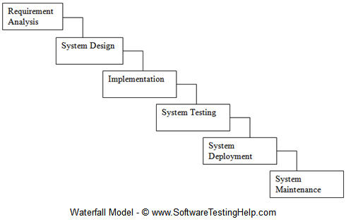
Waterfall Model
Waterfall Model or linear-sequential life cycle model is very simple. It is just like water fall.
Each phase must be completed before the next phase can begin and there is no overlapping in the phases.
In this Waterfall model, typically, the outcome of one phase acts as the input for the next phase sequentially.

Slide 5
When to use Waterfall Model
Requirements are stable and not changed frequently.
An application is small.
There is no requirement which is not understood or not very clear.
The environment is stable
The tools and technology used is stable and is not dynamic
Resources are well trained and are available.

Slide 6
Example of Waterfall Model
A healthcare company wants to create a new software product.
Here is the timeline it decides on for the project phases:
6 months for requirements gathering and definition
8 months for design
5 months for coding
3 months for testing
just four months into the project, the company’s compliance office changes its stance on an existing government regulation, and announces new guidelines.

Slide 7
The result: Buggy software, delivered late
QA ends after six months, three months longer than expected. The software is buggy but works if you know just the right combination of steps to take.
The project is now 19 months behind schedule. Pressured by angry users and investors, the company has no choice but to release it. And the results are less than stellar.

Slide 8
Projects which used Waterfall Model?
your clients just can't change your requirements midway
Example-
An airplane,
a gigantic bridge,
a 50+ floors building,

Slide 9
Advantages of Water fall Model?
Simple and easy to understand and use.
For smaller projects, waterfall model works well and yield the appropriate results.
Since the phases are rigid and precise, one phase is done one at a time, it is easy to maintain.
The entry and exit criteria are well defined, so it easy and systematic to proceed with quality.
Results are well documented.

Slide 10
Disadvantages of WaterFall Model?
Cannot adopt the changes in requirements
It becomes very difficult to move back to the phase. For example, if the application has now moved to the testing stage and there is a change in requirement, It becomes difficult to go back and change it.
Delivery of the final product is late as there is no prototype which is demonstrated intermediately.
For bigger and complex projects, this model is not good as a risk factor is higher.
Not suitable for the projects where requirements are changed frequently.
Does not work for long and ongoing projects.
Since the testing is done at a later stage, it does not allow identifying the challenges and risks in the earlier phase so the risk mitigation strategy is difficult to prepare.

Slide 11
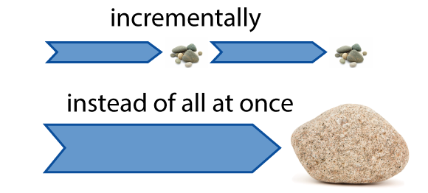
Agile Model
Agile is a time boxed, iterative approach to software delivery that builds software incrementally from the start of the project, instead of trying to deliver it all at once near the end.
It works by breaking projects down into little bits of user functionality called user stories, prioritizing them, and then continuously delivering them in short two week cycles called iterations.

Slide 12

Agile- Iterative Development
Iterative development means starting with something really simple, and adding to it incrementally over time.
It means evolving the architecture, accepting that your requirements are going to change, and continuously refining and tweaking your product as you go.

Slide 13
Agile Manifesto
Focus should be more on individuals and interactions instead of processes and tools
Working software is more important that comprehensive documentation
Customer collaboration is more vital than contract negotiation
The process should respond to change rather than follow a plan
Notes:
agile is a set of principles for actions that keep a software development team organized and efficient. Agile started when in 2001, a team of software developers got together in Utah for a weekend of fun and discussion. They compiled their views and principles into a document that is easy to understand and apply. Which we refer to as Agile Manifesto.

Slide 14
12 principles of agile software development:
Deliver customer satisfaction by delivering valuable software continuously
Always accept change of requirements matter how early or late in the project
Deliver software that works within a shorter timescale
Both developers and business professionals must work closely together daily throughout the duration of the project
Information is best transferred between parties in face-to-face conversations
Motivate people to build a project by creating an environment of appreciation, trust, and empowerment

Slide 15
Cont…
Working software is the key measure of progress
The agile process promotes sustainable development
Continuous attention to excellence and quality in technical development and design boosts the agility
Simplicity is a vital part of effective agile management
Self-organized teams produce the best architecture, requirements, and design
Teams should reflect through inspection and adaption to be more effective

Slide 16
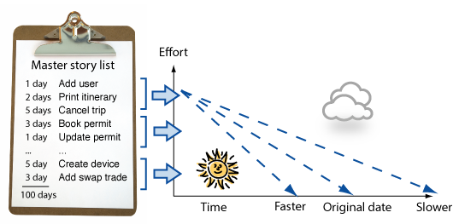
How does Agile works?
make a list
size things up
set some priorities
start executing
update the plan as you go.
Notes:
How does it work?
You make a list
Sitting down with your customer you make a list of features they would like to see in their software. We call these things user stories and they become the To Do list for your project.
You size things up
Then, using Agile estimation techniques, you size your stories relatively to each other, coming up with a guess as to how long you think each user story will take.
You set some priorities
Like most lists, there always seems to be more to do than time allows. So you ask your customer to prioritize their list so you get the most important stuff done first, and save the least important for last.
You start executing
Then you start delivering some value. You start at the top. Work your way to the bottom. Building, iterating, and getting feedback from your customer as you go.
You update the plan as you go.
Then, as you and your customer starting delivering, one of two things is going to happen. You'll discover:
You're going fast enough. All is good. Or,
You have too much to do and not enough time.
At this point you have two choices. You can either a) do less and cut scope (recommended). Or you can b) push out the date and ask for more money.

Slide 17
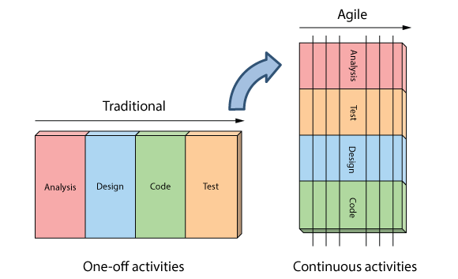
The Agile Approach vs waterfall

Slide 18
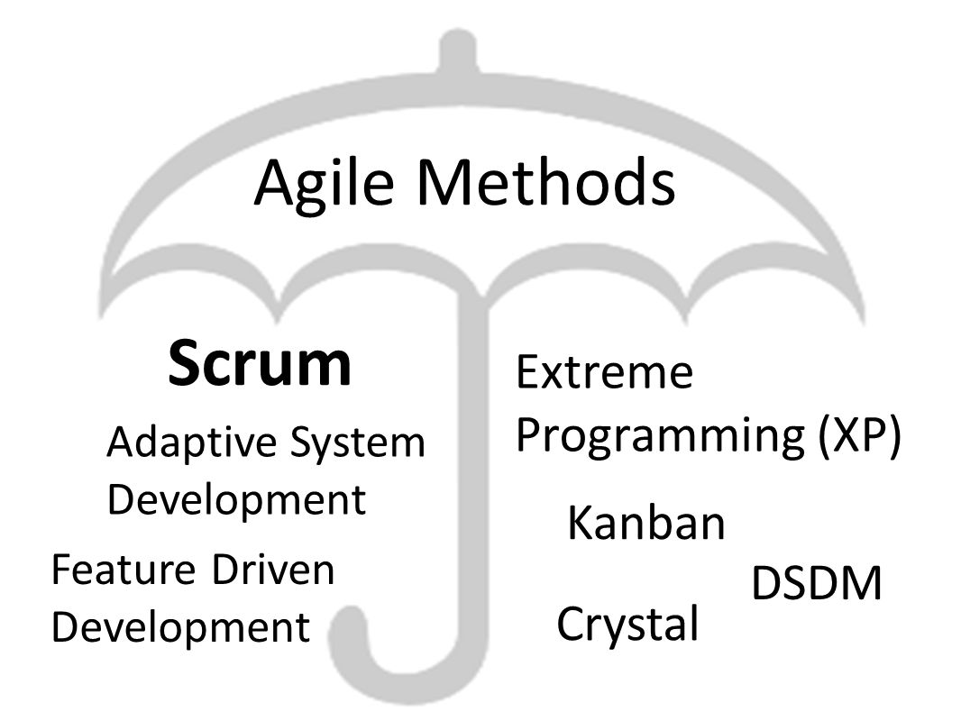
Agile Methods

Slide 19
Scrum
Scrum is a lightweight agile framework that can be used to manage iterative and incremental projects of different types.
break large complex projects into smaller stages, reviewing and adapting along the way.
Scrum looks at how to optimise predictability as well as control risk using an Iterative and Incremental approach
three pillars required for implementation: Transparency, Inspection and Adaptation.

Slide 20
Uses of Scrum
Scrum has been used extensively, worldwide, to:
Develop software, hardware, embedded software, a network of interacting function, etc
Research and identify viable markets, technologies, and product capabilities
Develop products and enhancements
Release products and enhancements very frequently
Develop and sustain cloud environments for product use
Sustain and renew products

Slide 21
People & Parts of Scrum Framework
The Scrum Framework is made of three distinct categories, which are:
Scrum Roles
Events in Scrum
Scrum Artifacts

Slide 22
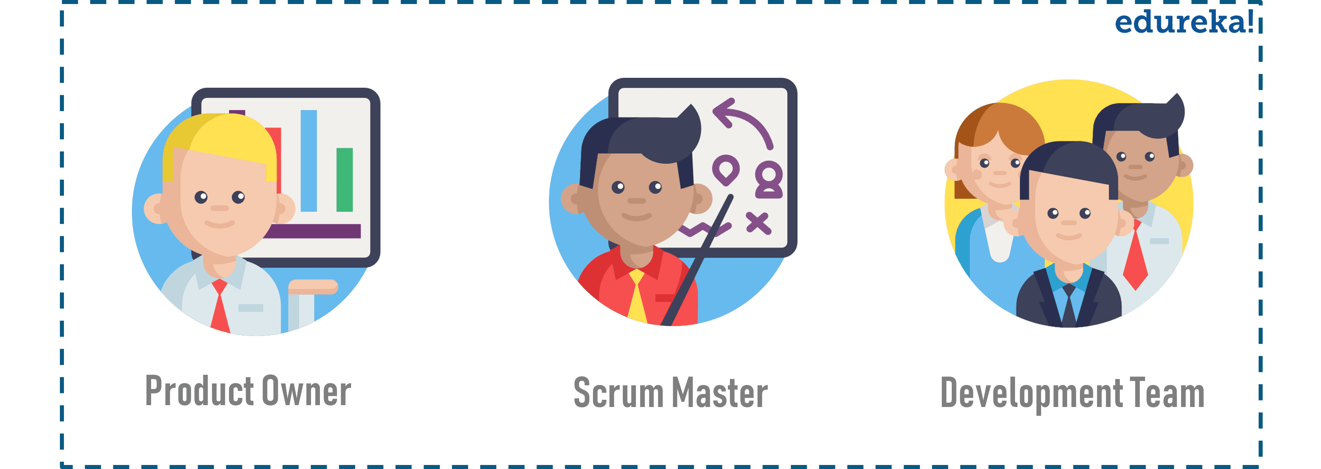
Scrum Roles
Product Owner
responsible for the work the team is supposed to complete.
to motivate the team to achieve the goal and the vision of the project.

Slide 23
Cont..
Scrum Master
To makes sure that the goals and scope of the project are understood by everyone involved
Remove impediments & obstacles that could slow down the team’s progress
Guide the team and product owner to improve the effectiveness of their practices
The Development Team(Scrum Team)
is a self-organizing and a cross-functional team, working together to deliver products.

Slide 24
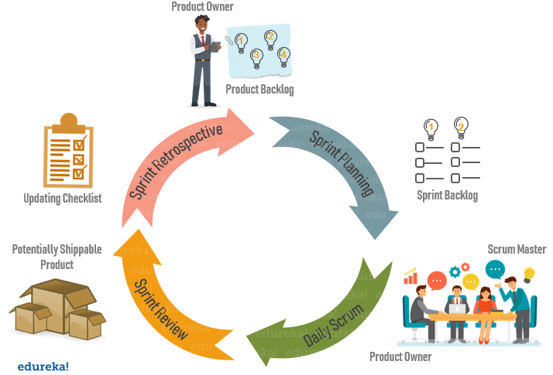
Events in Scrum

Slide 25
Sprint
A scrum sprint basically is a specified time period during which a Scrum Team produces a product.
It forces prioritization, demonstrates progress, avoids unnecessary perfections, motivates closure, improves predictability and improves the return of investment.
The duration of a sprint is determined by the scrum master,
During the sprint, the team holds daily standup meeting to discuss progress and brainstorm solutions to challenges.
Notes:
Scrum Planning
It is a meeting where the work to be done during a sprint is mapped out and the team members. During this meeting, the entire team clearly defines deliverables for the Sprint and assigns the work necessary to achieve that goal. It is an event where you can get answers to the following questions:
What can be delivered in this Sprint iteration?
The development team decides on the functionality to be worked upon during the sprint duration. The product owner modifies product backlog accordingly and discusses the project target that a Sprint should achieve. Entire scrum team takes part in Sprint Planning to understand the work or tasks to be performed in that Sprint and create a sprint goal.
How to achieve that work?
Once the entire team agrees on the product backlog items and sets the Sprint goal, the development team starts developing the functionality. It does so by designing the system and the work needed to convert the Product Backlog into a working product Increment. By the end of sprint planning, the development team should be able to explain how it is going to accomplish the Sprint Goal.

Slide 26
Scrum Planning (Cont..)
meeting where the work to be done during a sprint is mapped out and the team members
It is an event where you can get answers to the following questions:
What can be delivered in this Sprint iteration?
How to achieve that work?
Notes:
Scrum Planning
It is a meeting where the work to be done during a sprint is mapped out and the team members. During this meeting, the entire team clearly defines deliverables for the Sprint and assigns the work necessary to achieve that goal. It is an event where you can get answers to the following questions:
What can be delivered in this Sprint iteration?
The development team decides on the functionality to be worked upon during the sprint duration. The product owner modifies product backlog accordingly and discusses the project target that a Sprint should achieve. Entire scrum team takes part in Sprint Planning to understand the work or tasks to be performed in that Sprint and create a sprint goal.
How to achieve that work?
Once the entire team agrees on the product backlog items and sets the Sprint goal, the development team starts developing the functionality. It does so by designing the system and the work needed to convert the Product Backlog into a working product Increment. By the end of sprint planning, the development team should be able to explain how it is going to accomplish the Sprint Goal.

Slide 27
Daily Scrum(Cont..)
known as a stand-up, it is a 15-minute daily meeting
What was done yesterday by the scrum team that helped meet the sprint goal?
What will be done today that will help meet the sprint goal?
Are there impediments that are preventing the team from meeting the sprint goal?
Notes:
Also known as a stand-up, it is a 15-minute daily meeting where the team has a chance to get on the same page and put together a strategy for the next 24 hours. The entire daily scrum meeting is based on discussing three-question listed below:
What was done yesterday by the scrum team that helped meet the sprint goal?
What will be done today that will help meet the sprint goal?
Are there impediments that are preventing the team from meeting the sprint goal?

Slide 28
Sprint Review
Sprint Review meeting is held at the end of each sprint
It doesn’t have a fixed time frame. It lasts at most for 4 hours for a one-month sprint or can be shorter for shorter sprints
The scrum team and the stakeholders collaborate and plan for the next sprint goal
The team does research on the marketplaces and estimates the budget, potential capabilities, timeline, and marketplaces for the upcoming releases
Notes:
Sprit Review
During the sprint review, product owner explains what the planned work was and what was not completed during the Sprint. The team then presents completed work and discuss what went well and how problems were solved. Here are some important points related to scrum review:
Sprint Review meeting is held at the end of each sprint
It doesn’t have a fixed time frame. It lasts at most for 4 hours for a one-month sprint or can be shorter for shorter sprints
The scrum team and the stakeholders collaborate and plan for the next sprint goal
The team does research on the marketplaces and estimates the budget, potential capabilities, timeline, and marketplaces for the upcoming releases
Thus, keeping all these factors in mind, a revised Product Backlog is the result at the end of the Sprint Review Meeting.

Slide 29
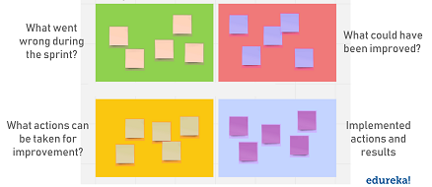
Sprint Retrospective
Notes:
During sprint retrospective, the team discusses what went right, what went wrong, and how to improve. They decide on how to fix the problems and create a plan for improvements to be enacted during the next sprint. Regardless of how good a Scrum team is, there is always room for improvement. A good Scrum team will always focus on continuous improvement opportunities which is usually discussed in the Sprint Retrospective Meeting.

Slide 30
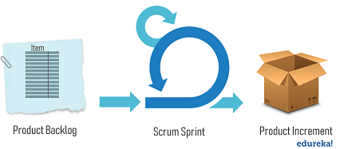
Scrum Artifacts
Artifacts are just physical records that provide project details when developing a product.
Product Backlog
list of tasks and every requirement that the final product needs.
Sprint Backlog
real-time picture of the work that the team currently plans to complete during the sprint.
Product Increment
the sum of product work completed during a Sprint, combined with all work completed during previous sprints.
Notes:
Scrum Artifacts
Artifacts are just physical records that provide project details when developing a product. Scrum Artifacts include:
Product Backlog
It is a simple document that outlines the list of tasks and every requirement that the final product needs. It is constantly evolving and is never complete. The Product Owner manages the Product Backlog, including how it’s made available to the scrum team, its content, and how it’s ordered, everything. The Product Owner and the rest of the scrum team work together to review the Product Backlog and make adjustments as and when necessary. For each item in the product backlog, you should add some additional information like:
Description
Order based on priority
Estimate
Value to the business
Sprint Backlog
It is the list of all items from the product backlog that need to be worked on during a sprint. Team members sign up for tasks based on their skills and priorities. It is a real-time picture of the work that the team currently plans to complete during the sprint. Here are some important points about sprint backlog:
The sprint backlog is dynamic in nature because each scrum sprint has repeated changes to reach the goal
It is the outcome of sprint planning meeting sessions
The development team owns the sprint backlog and divides tasks according to their skills
It is a highly visible, real-time picture of the work that the Development Team plans to accomplish
Product Increment
The most important artifact is the product improvement, or in other words, the sum of product work completed during a Sprint, combined with all work completed during previous sprints. Important point is that the increment must be in useable condition regardless of whether the Product Owner decides to release it.

Slide 31
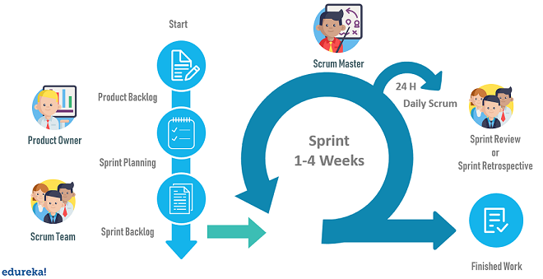
How does a Scrum Process Work?
Notes:
Step1: Scrum process begins with a product owner. Product Owner creates a product backlog, a list of tasks and requirements the final product needs. The important part is that product backlog must be prioritized.
Step2: The scrum team gets together for sprint planning, which is when the team decides together what to work on first from the product backlog. This subset of items from the product backlog becomes the sprint backlog.
Step3: During the sprint, the team meets to communicate progress and issues, this meeting is called the daily scrum. It is overseen by the scrum master who ensures that all the team members follow scrum’s theories, rules, and practices.
Step4: At the end of the sprint, the sprint review meeting is organized by the product owner. During the meeting, the development team demonstrates what they completed since the last sprint. Then the product owner gives information about what is remaining on the product backlog and estimated time to complete the project if needed.
Note: In scrum, at the end of each sprint, the team should have a functioning piece of the product to show for their work.
PMP® Certification Training Course
Weekday / Weekend BatchesSee Batch Details
Step5: After the sprint review, the scrum team gathers-up in sprint retrospective meeting, where the team discusses what went well, what did not and if they could have done better. Might be a tech limitation is holding them back or a team member is overloaded with tasks. The team decides how to fix these problems and creates a plan for improvements to be enacted during the next sprint.
Step6: The cycle repeats for the remaining tasks in the product backlog. This goes on until either of the below-mentioned things happen:
The deadline has been reached
The budget is exhausted
The product owner is satisfied with the final product

Slide 32
Thank You & Query

